Slide 2
Lambda architecture simplified
BRK4018
with Azure Cosmos DB and Azure Databricks
Luis Bosquez
Program Manager
lbosq@microsoft.com
Twitter: @_lbosq

Slide 3

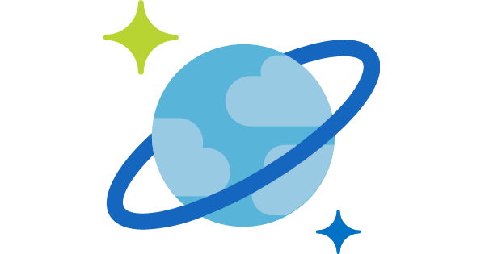

Slide 4
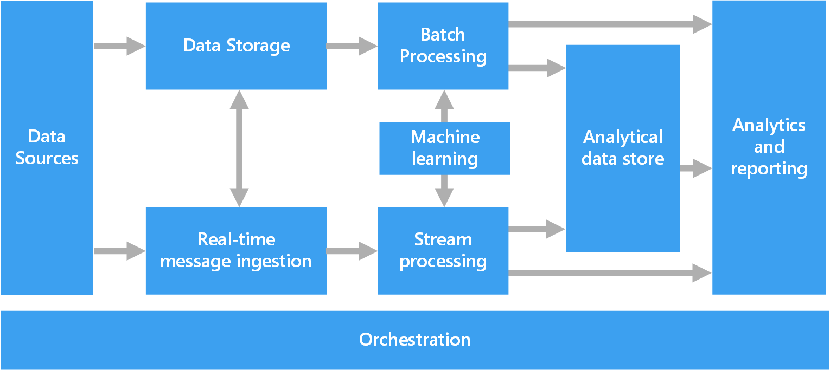
https://docs.microsoft.com/en-us/azure/architecture/data-guide/big-data/

Slide 5
Is big data too big of a challenge?
Business questions range from real-time data to historical data.
Usually solved with streaming layers through HDFS for data processing.
Combination of technologies between streaming components, data stores and serving layers.
Infrastructure can be complex to set up and manage.

Slide 6
How can the cloud address these challenges?

Slide 7
What can we use to modernize big data processing?
Cloud-managed services:
To provide minimal manageability, scalability and flexibility.
A pattern that provides guidelines to address data processing requirements:
Lambda architecture: A simplified, repeatable approach to address batch and real-time data processing.

Slide 8


Requirements
Solutions
The tolerance to human errors
The tolerance to hardware crashes
Scalability and quick response time
Automated data processes
Managed cloud systems
Serverless architecture
https://www.talend.com/blog/2016/05/31/the-lambda-architecture-and-big-data-quality/

Slide 9
Using the cloud to solve manageability challenges

Slide 10
Management Requirements
Application Logic
Application Runtime
Application Logic
Operating System
Application Runtime
Application Logic
Hardware
Operating System
Application Runtime
Application Logic
On-premise
IaaS
PaaS
Serverless
Abstraction
Control

Slide 11

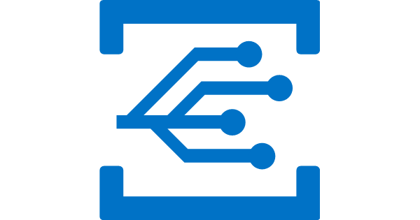

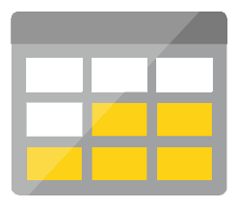

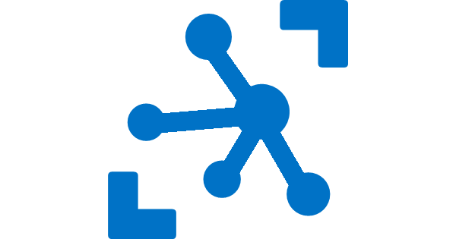

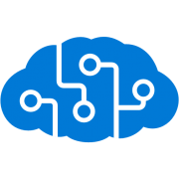
Serverless application platform components
Development
Platform
IDE support
Event Grid
Logic Apps
Functions
Manage all events that can trigger code or logic
Design workflows and orchestrate processes
Execute your code based on events you specify
Integrated DevOps
Local Development
Monitoring
Database
Storage
Security
IoT
Analytics
Intelligence
Visual Debug History

Slide 12
What about the data architecture?

Slide 13
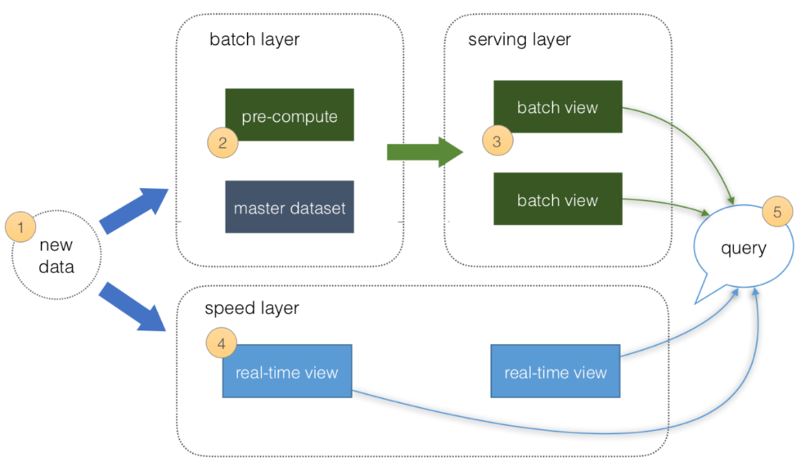
What is a Lambda Architecture?

Slide 14
What are the challenges with the lambda architecture?
Too many moving parts:
Choose a database for aggregate storage, serving, real-time data processing.
Choose a streaming technology for speed-layer.
Choice between streaming technologies and databases for batch aggregation.
Too many technologies to maintain.
Lack of managed options that can provide an end-to-end experience.

Slide 15
Simplifying the lambda architecture with Cosmos DB

Slide 16
Need for a lambda architecture
Both real-time and aggregated data processing.
A scalable architecture with tunable components.
Database(s) with workloads of different nature:
Cosmos DB can address these scenarios by providing tunable data querying in different collections.
Component | Read frequency | Write frequency | Storage size
Speed layer | Real-time | Real-time | Minimal/Stream
Batch layer | Periodical | Periodical | Batch size
Master dataset | Both | Both | Batch size + historical

Slide 17
Approaching big data, the Cosmos DB way
Why can Cosmos DB address these requirements?
Service guarantees - high availability, minimal latency, comprehensive SLAs
Adapts to all sizes of databases through elastic throughput
Provides automatic data maneuvering through Change Feed
Integrates natively with data processing engines -> Apache Spark
Integrates natively with serverless components.

Slide 18
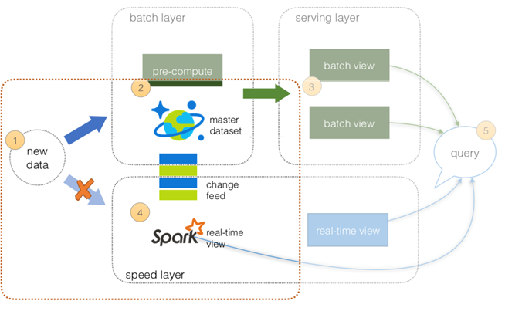

Slide 19
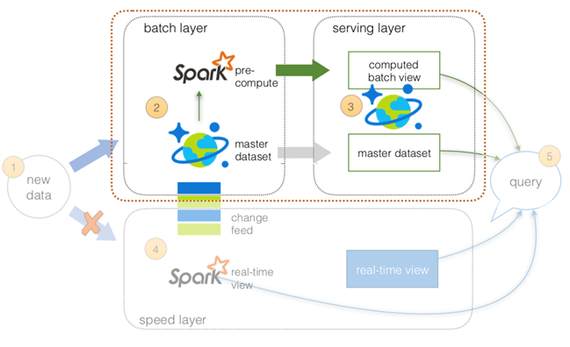

Slide 20
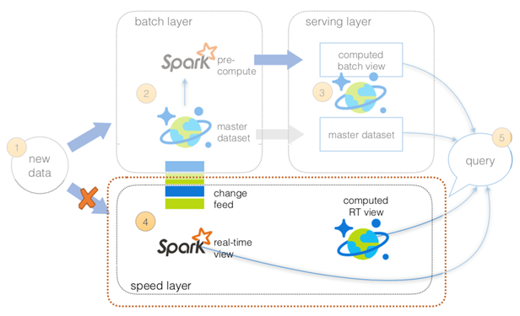

Slide 21
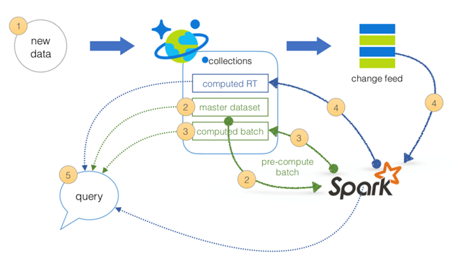

Slide 22
Cosmos DB for the master dataset, computed storage and serving layer

Slide 23



What is Azure Cosmos DB
A globally distributed, massively scalable, multi-model database service
Table API
MongoDB
SQL
Key-value
Column-family
Document
Graph
Guaranteed low latency at the 99th percentile
Elastic scale out
of storage & throughput
Five well-defined consistency models
Turnkey global distribution
Comprehensive SLAs

Slide 25
How does it address it?
Serves multiple clients in parallel.
Can host data of any size automatically.
Millisecond response for read operations.
Elastically provision partitions.
Different collections can adapt to the different use cases and access patterns.

Slide 26
Cosmos DB Change Feed

Slide 28
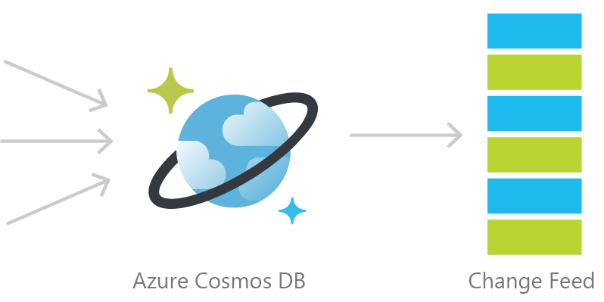
Persistent log of documents within an Azure Cosmos DB collection in the order in which they were modified.
An approach to a streaming layer.

Slide 29
Change Feed's benefits
Automatically enabled in any Cosmos DB database account.
Doesn’t need any additional configuration to start working.
Uses the existing allocated request units for processing events.
Executed on insert and update operations. Delete support can be implemented with a flag.
Can be used as a streaming layer without requiring another component.

Slide 30
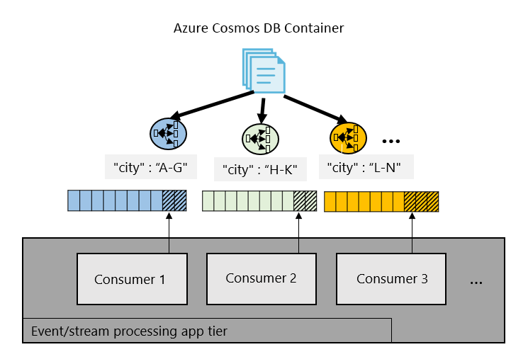
Change log

Slide 31
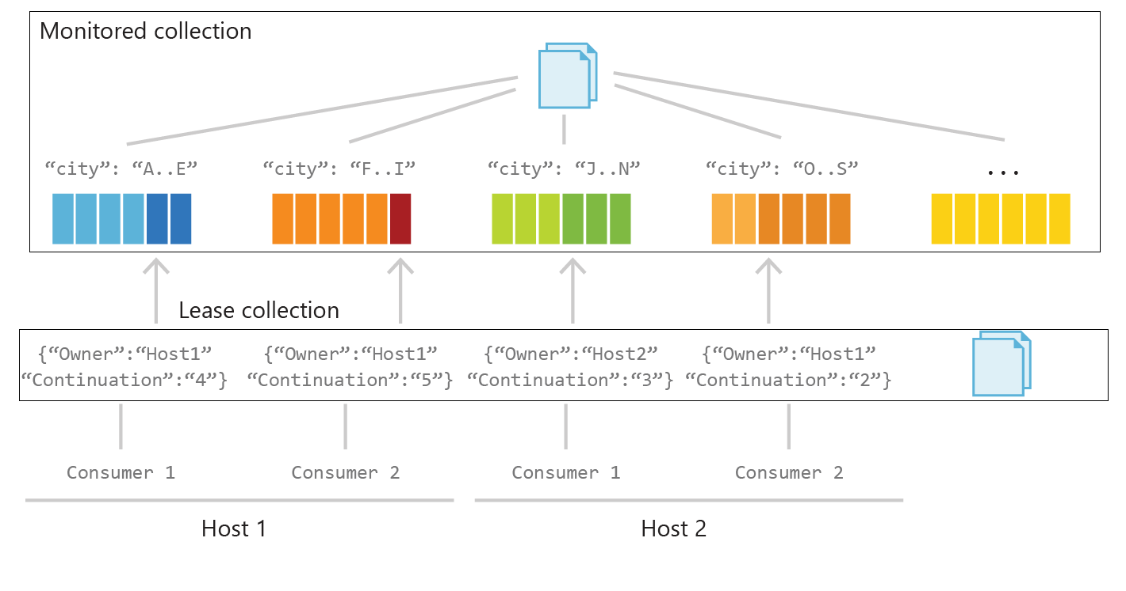

Slide 32
How to implement Change Feed
Implementation | Use Case | Advantages
Azure Functions | Serverless applications | Easy to implement. Used as a trigger, input or output binding to an Azure Function.
SQL API SDK | Custom applications | More control over behavior of change feed. Requires manual implementation in a .NET application.
Change Feed Processor Library | Distributed applications | Ability to distribute the processing of events towards multiple clients. Requires a “leases collection”.

Slide 33
Cosmos DB and Apache Spark
through Azure Databricks

Slide 34

What is Apache Spark?
Open-source cluster computing framework.
Scalable data processing layer with implicit parallelism and fault-tolerance.
Simple programmability with extensible libraries.
Uses scale-out/horizontal provisioning of nodes.
Provides a standard platform for processing jobs that require powerful computation.

Slide 35

What is Azure Databricks?
Managed cloud solution for Apache Spark.
Uses an optimized version of Spark.
Provides abstracted control of clusters/nodes with cloud resources.
Easy to use interface similar to jupyter notebooks.
Provides Python, SQL and Scala environments.
Highly configurable for library and runtime environment versions.
Azure Databricks

Slide 36
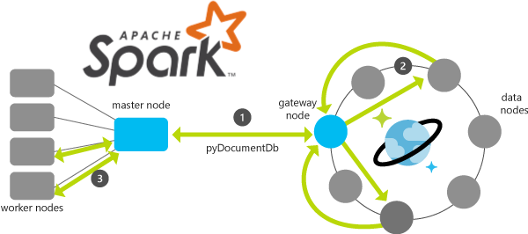
Cosmos DB Native Integration with Spark
Available for both Python and Scala/Java

Slide 38
Demo A lambda architecture using Cosmos DB and Azure Databricks

Slide 39
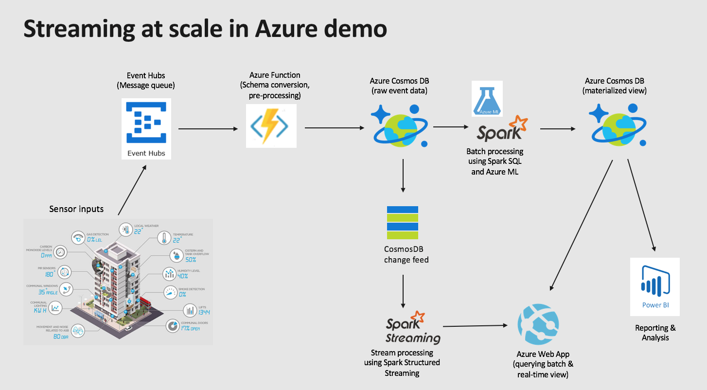

Slide 40
Demos
Ramzi Abu-Abed, Nimra Choudhary
Microsoft Supply Chain

Slide 41
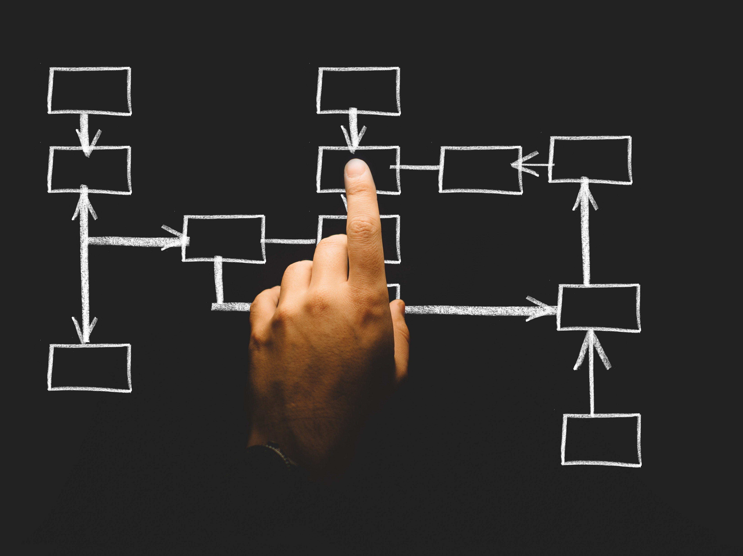
Microsoft Supply Chain
Ramzi Abu-Abed
Nimra Choudhary

Slide 42
Please evaluate this session Your feedback is important to us!
Please evaluate this session through MyEvaluations on the mobile app or website.
Download the app: https://aka.ms/ignite.mobileApp
Go to the website: https://myignite.techcommunity.microsoft.com/evaluations

